Slide 1

Welcome to SVGS!
New Student and Parent Meeting
Notes:
BH
Congratulations!
Students - We are excited to welcome you to SVGS for 2022-23 school year.
Parents - Your student has worked hard for this opportunity and has been selected to become a valued part of a unique educational environment. This was an extremely competitive applicant pool with an acceptance rate of about 65%. Congratulations to you also! We recognize your impact and value your support.

Slide 2
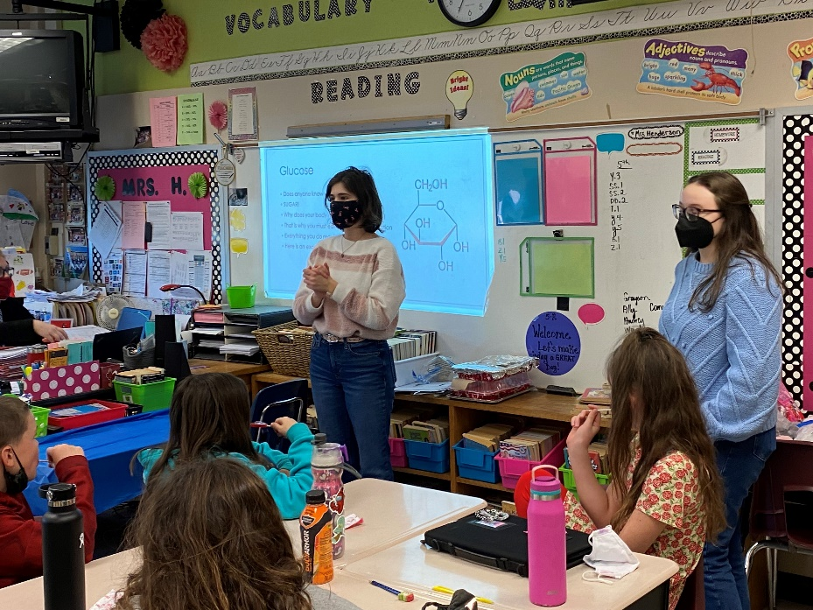
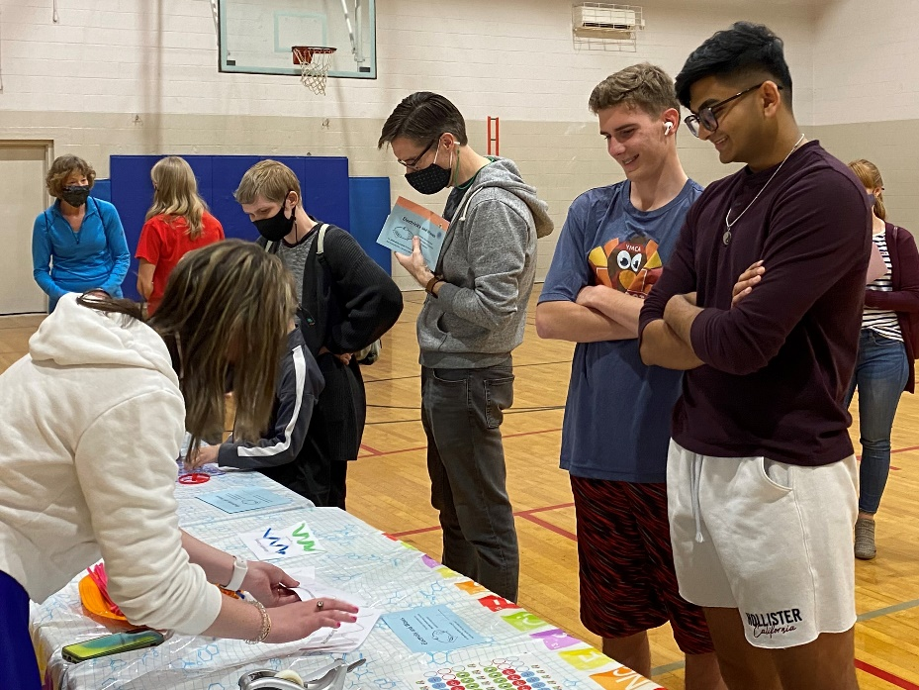
SVGS “Mission”
To provide a challenging environment for learning in the arts and sciences
To provide practical and professional opportunities for building skills and knowledge necessary for success here, in college, and throughout life
To provide support for students as they grow and adjust to new intellectual and personal challenges
Notes:
BH
The Mission of SVGS:
To provide a challenging environment for learning in the arts and sciences,
To provide practical and professional opportunities for building skills and knowledge necessary for success here, in college, and through life.
To provide support for students as they grow and adjust to new intellectual and personal challenges
At SVGS, students are asked to demonstrate their abilities and talents in different ways and to become effective independent learners and thinkers.
Ignite interests and develop talents in specific areas
Expand knowledge
Improve skills thinking, analysis, creativity and problem solving
Foster sense of personal and social responsibility
We help students understand and appreciate their ability to positively affect the world as the leaders, thinkers and creators of the next generation. This is our responsibility to you.

Slide 3

SVGS “Skills for the Ages”
Notes:
BH
SVGS is not a typical high school.
SVGS will provide a comprehensive, intellectually challenging program for gifted learners, high achievers and creative thinkers in a community of learners setting that extends and enriches their education by providing rich, deep, learning experiences to foster skills and habits of mind necessary to living successful lives.
SVGS has identified nine skills as critical to life-long learning and performance in any academic discipline and profession.
Transition to SB

Slide 4
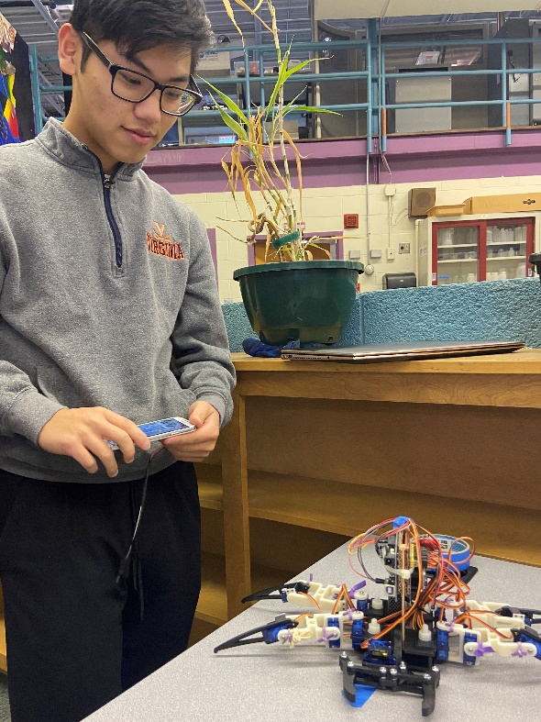
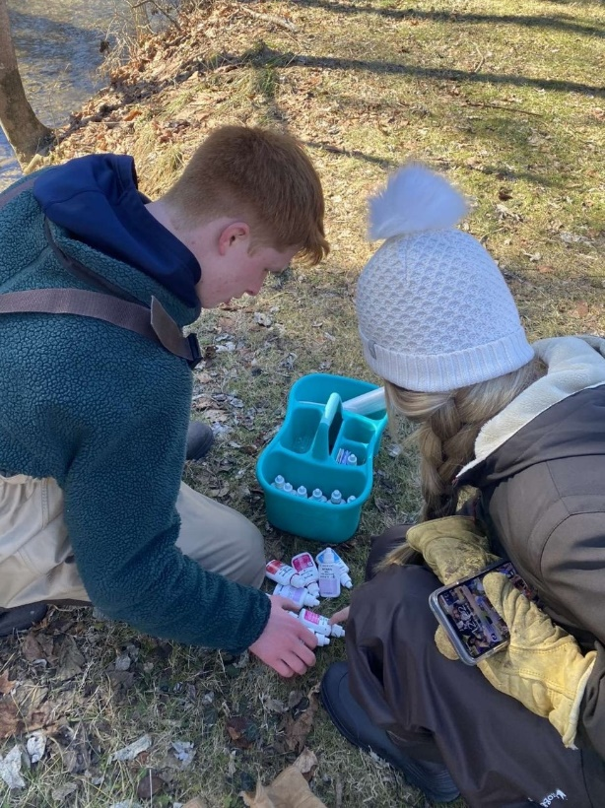
Expectations of Students
Value Opportunities
Respect
  Accomplishments
  Talents
  Differences
Contribute
  Learning environment
  Group & individual work
Show Responsibility
    Attendance
    Promptness
    Communication
    Participation
Notes:
SB
As students, you have expectations as valued members of this school. This includes your responsibilities to Governors School, to your fellow students and most importantly yourself.
Value
the opportunities and resources you have here to learn and grow
Respect
The accomplishments, talents, and differences of those around you – both students and staff
Being different is interesting – there is nothing inferior or superior about it.
None of you are normal –Everyone has his or her quirks , you will get on each others nerves at times.
Contribute
The learning environment
The classroom experience
Group and individual work –
Some of you like to work by yourself, some like to work together. You will do both.
When you work as a group, expect to pull your weight.
Show Responsibility
Attend
Be Prompt
Communicate
Ask for help when needed
Talk with teachers about absences/conflicts
Participate
Take responsibility for your own learning.
You have the power and talent to contribute to discussions and that is what we expect.
Be responsible to yourself by respecting and trusting your abilities. You would not be here if we didn’t see that in you.

Slide 5


SVGS “Legacy”
As an SVGS student, you will benefit because of the dedication, commitment, and service of those before you.
It is your responsibility to continue that legacy.
Notes:
SB
You benefit from being recognized in the community and with colleges as being a governors school student only because of the dedication, commitment, and service of those students before you.
It is your responsibility to continue that legacy!

Slide 6
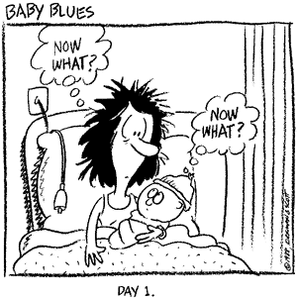
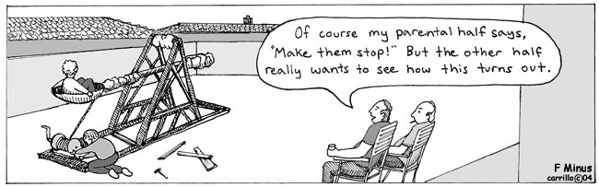
Guidance for Parents
Support Development
  Intellectual
  Emotional
Guide Time Management
Ask Questions
Get Involved
Notes:
SB
From Day 1 – we may have wished to have an instruction manual that will guide us in raising our children
Although we don’t offer an instruction manual – we do offer some guidance for parents.
Support your child’s development
intellectual
emotional
Guide/Support time management
Ask your child questions
Get involved in their learning and in our programs (PSAC)
- as you have throughout their education
- may/will take more
- we recognize their positive efforts that have gotten students to this place - continue!
Cartoon – laughter for transition to BH

Slide 7

Making the Next Move...
What’s your Strategy?
Notes:
BH

Slide 8

Notes:
BH
Many students have a misconception that intelligence is fixed and think that needing to expend effort to learn indicates low intelligence.
When students with a fixed mindset encounter a concept that they do not immediately and effortlessly understand, they typically believe that they are incapable of mastering it and thus expend less effort to learn. This also happens when students are used to spending minimal effort to achieve success.
The most successful students have a growth mindset - they believe that their talents and abilities can be developed through passion, education, and persistence.
For them, it’s not about looking good for college or their transcript.
It’s about a commitment to learning
-taking informed risks and learning from the results,
-surrounding yourself with people who will challenge you to grow
-looking frankly at your deficiencies and seeking to remedy them.
If you do these things, your future will become your reality.

Slide 9
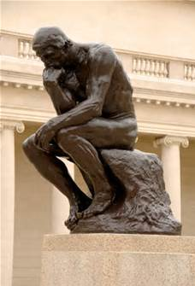
Depth and Quality of Work
  Time and Preparation vs. Talent and Ability
  Complex Material
  Compact Time Frame
  Faster Pace
  Outside of Previous Comfort Zone
  Unable to Coast
Notes:
BH
Simply completing an assignment doesn’t guarantee a good grade. It is the depth and quality of work that counts.
At SVGS, this requires more time and preparation. Simply being talented in one area or medium isn’t enough because you will be expected to try new things.
Students will be asked to learn complex material
Material is dense – compacted time frame for advanced learning
Work at a different pace, in different ways through different activities.
Some student will be out of their previous comfort zone.
Some are used to coasting – listening quietly in class, competing what was asked, glancing at the textbook while texting with friends, completing HW during the 90 minute block or in the morning between the shower and the door.
In the past that might have been enough.
That does not work at SVGS.

Slide 10

Our “Equation for Success”
  Level of Challenge > Current Skill = Learning
Notes:
BH
Equation for Success:
A Level of Challenge greater than a Student’s Current Skills equals LEARNING.
You are not learning anything, if you can do it already.
Struggle is a critical part of learning; it is not failure.
So – let’s talk more about that struggle…

Slide 11

Students may face some
unexpected pitfalls!
Notes:
BH –
Again - Here are some specific challenges:
Higher Rigor
Challenging material
New approach to learning
This joke’s kind of “cheesey” – But be prepared for a “grater workload”
Transition to SB

Slide 12

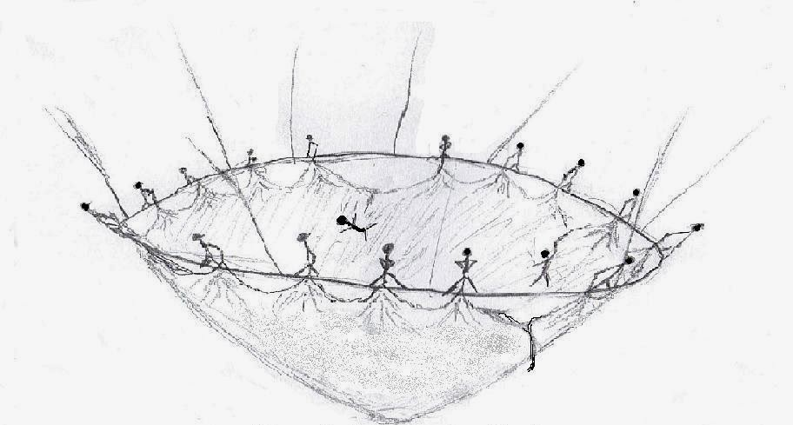
College
with a “Safety Net”
Notes:
SB –
Question: When things get tough – how do we cope? How do we not just survive - but thrive?
Answer: We learn to lean on others.
At Governor’s School, we are a community of learners. Students, teachers, and staff are actively learning together. Connected. Cooperative. Supportive.
Despite this support, students will experience times that are uncomfortable or stressful. This is part of transition. This is part of growth. Growth both Academically and Emotionally requires the learning of life skills.
As said previously - challenge faced must exceed current skill if we want to learn and grow. You cannot learn anything if you can do it already. Struggle is a critical part of learning; it is not failure.
During our high school visits this past year – a current student used a phrase that has stayed with me –
“Gov School is like college, with a safety net.”
Our students have teachers and staff here that are holding that net. We join with a students parents, extended family, home high school, friends, neighbors and community in providing that support.

Slide 13
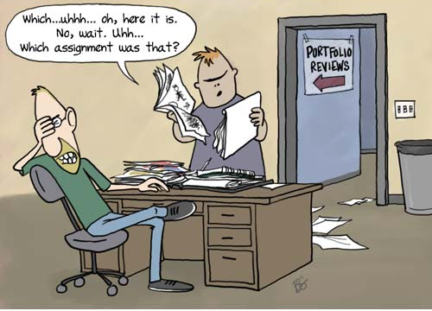
Organization
Notes:
SB
Organization
Students have many projects and assignments going at once.
Keeping up with assignments and due dates is often a new challenge for our students.
Teachers have course materials on CANVAS and post assignments there.
Many STEM teachers use a program called Webassign.
Students will get accustomed to looking at CANVAS and Webassign for resources.
Home School Email and SVGS Email – Must Check both
CALENDAR – Parents – help your students create a single system of keeping track before they get in over their head.
SVGS Infinite Campus Student Portal and Parent Portal – Separate from ACS, SHS (Power School), WHS

Slide 14
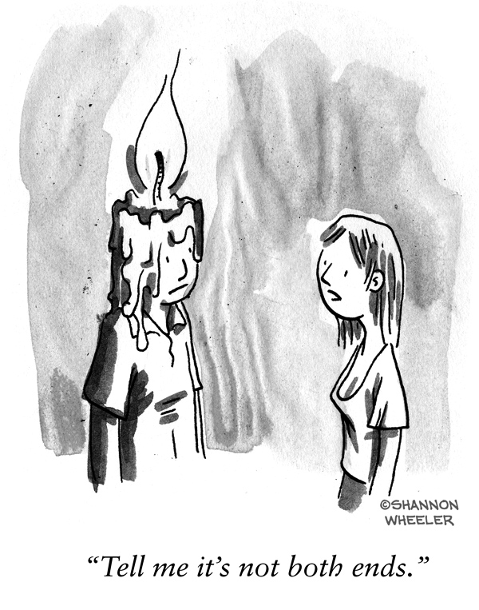
Time Management
Notes:
SB
Time Management
Our students are busy, active and social young adults. Most are involved in many extra-curricular activities, have outside work, and family responsibilities.
Academically - Assignments will be given with a due date – students are provided a period of time to complete that assignment.
– It is the student’s responsibility to stay on top of those deadlines – this often feels different than what they have experienced in HS
- Temptation to put things off to the last minute rather than make gradual progress.
Learning to effectively manage time and prioritize tasks are essential skills. Students currently have different skills in their ability to apply that in SVGS classes.
Students will learn to make productive use of their “down time” or independent work block (IWT).
Transition: Parents - you can support that process.

Slide 15
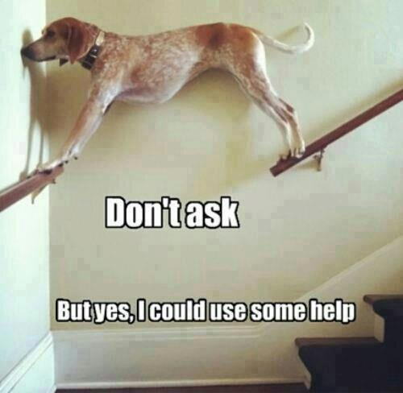
Notes:
SB
Parents - How you can help your student:
Avoid Overscheduling
Our students are enthusiastic and want to do it all. Help them prioritize and make positive choices. As their interests become more focused, the depth of their involvement in certain activities will change.
The former dean of admissions at UVA used to say he liked to see “well lop-sided” children. He looked for leadership experiences and significant commitment to a few activities as opposed to a laundry list of activities with minimal participation.
There will be times when students’ schedules overlap and they have to be in two places at once.
Or they will have multiple tasks to accomplish in a minimal amount of time.
Encourage them to communicate with teachers before conflicts become an issue. 90% of issues are resolved before they ever happen because of clear and timely communication.
Some stress can be productive. We are fortunately built to adapt to reasonable levels of stress. It is not how difficult the task is but the sense of control you have over the situation.
Be supportive by reassuring students they can rise to the occasion and help them problem solve to do so. Let us know how we can work together to assist your student. If you have concerns do not hesitate to contact your student’s teacher or either of us.

Slide 16
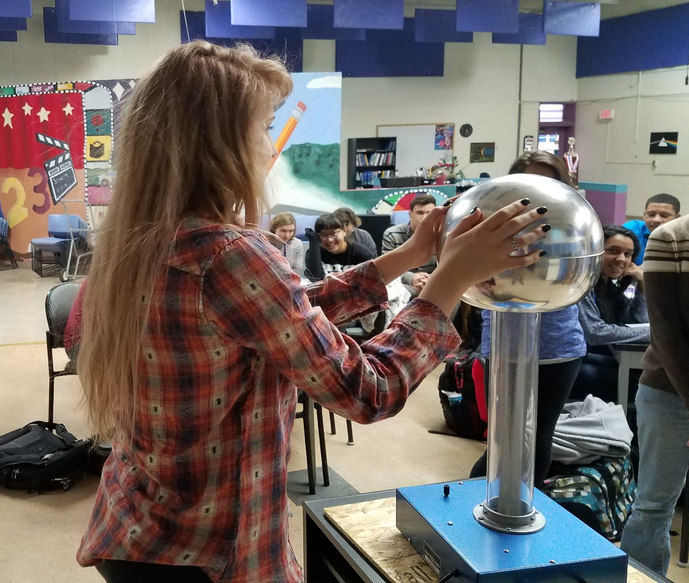
Tuesday, April 26 | “Memo of Understanding” Due
Tuesday, May 3 | Course Pre-Registration Due
  Link to SVGS Website
Notes:
SB
Tuesday April 26 – Memo of Understanding Due – Accept your acceptance
Tuesday, May 3 – Course Pre-Registration Due
All Needed information can be found on SVGS Website – SHOW using Link!

Slide 17
Advanced Placement (AP)
Dual Enrollment (DE)
Students take a national exam at end of course – early May
Performance on exam determines whether or not credit is earned
Score range is 1-5: occasionally a 3 will earn credit but more usually require a 4 or 5
Score is a result of mastery of content, standardized test-taking skills, AND health/attitude on day of exam
Accepted nation-wide at most highly selective universities
$96 per AP Exam
Taught at SVGS by SVGS teachers
Credit is earned through successful completion of class (grade of B or better) rather than one-time test
Credit is accepted to all public universities in Virginia
*Note – see next slide
DE Credits are less expensive than on-campus tuition
4 credit class – JMU DE = $400
4 credit class – BRCC DE = $125
  (Prices are approximate)
Notes:
SB
AP vs DE Comparison
AP
Students take a national exam at end of course – early May
Performance on exam determines whether or not credit is earned
Score range is 1-5: occasionally a 3 will earn credit but more usually require a 4 or 5
Score is a result of mastery of content, standardized test-taking skills, AND health/attitude on day of exam
Accepted nation-wide at most highly selective universities
$96 per AP Exam
DE
Taught at SVGS by SVGS teachers
Credit is earned through successful completion of class (grade of B or better) rather than one-time test
Credit is accepted to all public universities in Virginia
*Note – see next slide
DE Credits are less expensive than on-campus tuition
4 credit class – JMU DE = $400
4 credit class – BRCC DE = $125
(Prices are approximate)

Slide 18

    Review the “transfer guide” found on your specific college of interest’s website
    ALWAYS verify with colleges AND discuss with a college admissions counselor.
    Ask not just “Will they take the credit?” but “How will they take the credit?”
    May NOT transfer as required courses for general education or within major – may be elective credit
Notes:
SB
Transfer of College Credits
Review the “transfer guide” found on your specific college of interest’s website
ALWAYS verify with colleges AND discuss with a college admissions counselor.
Ask not just “Will they take the credit?” but “How will they take the credit?
May NOT transfer as required courses for general education or within major – may be elective credit

Slide 19
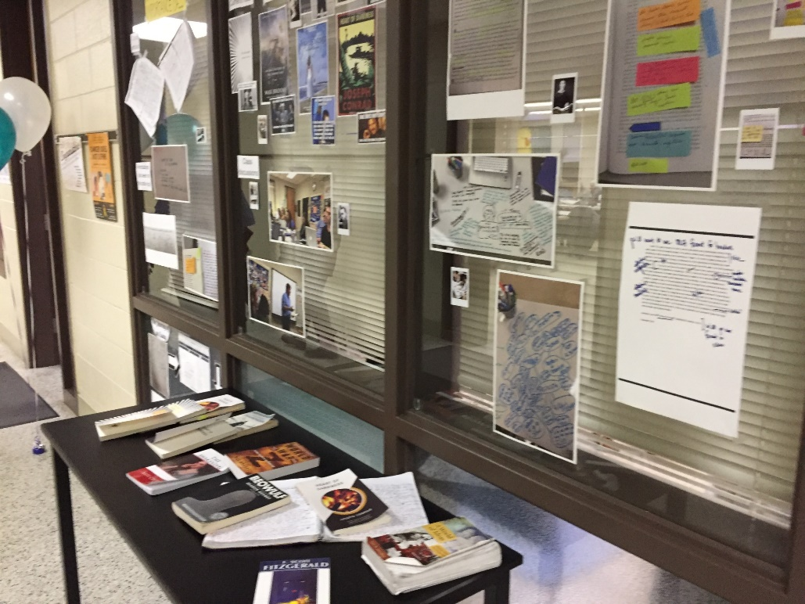
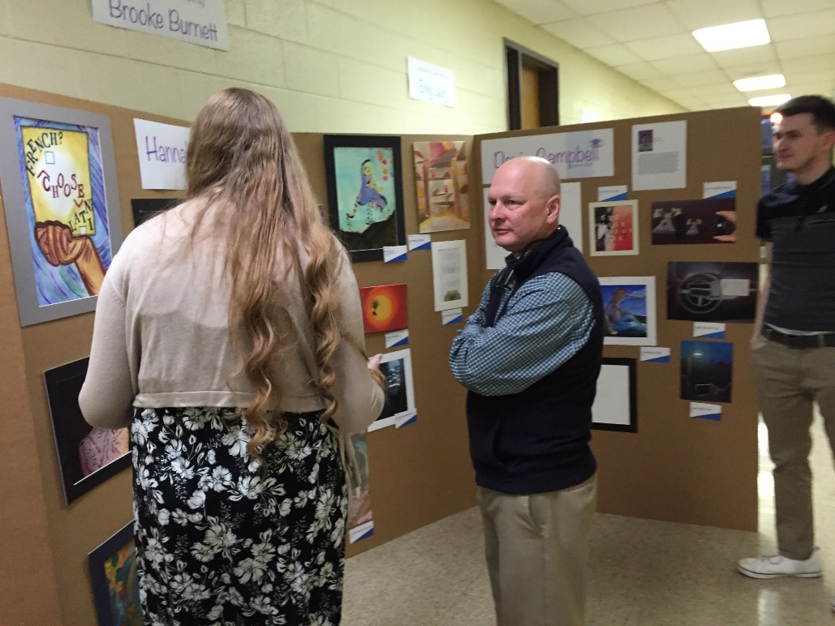

ARTS & HUMANITIES
Notes:
SB

Slide 20
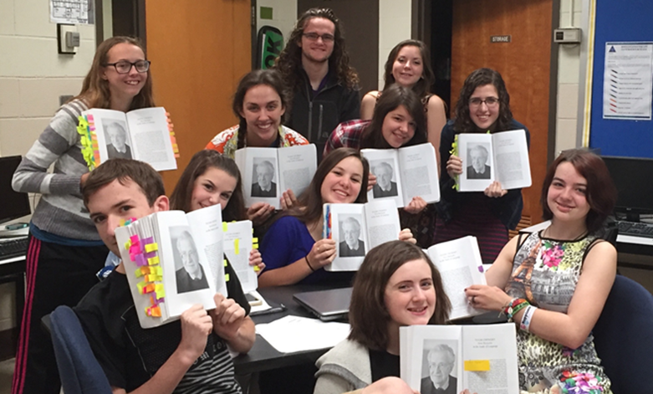
ARTS & HUMANITIES
Select three of the courses shown below.
 | Junior Year | Senior Year
Fulfills English Requirement | * Literature, Comp, and Ideas I (DE) (Required for all AH Juniors) | * Literature, Comp, and Ideas II (DE) (Recommended, but not Required)
Humanities & Appreciation | * Humanities in Western Culture (DE) * Art History (DE) * Drama History and Appreciation (DE) | * Communications (DE) * Art History (DE) * Drama History and Appreciation (DE)
Socio-Cultural and Skills | * Psychology (AP) * Developmental Psychology (DE) * Studio I * Acting I * Film I * Teachers for Tomorrow (DE) | * Psychology (AP) * Developmental Psychology (DE) * Sociology of the Family (DE) * Sociology of Mass Media (DE) * Studio II * Acting II * Film II * Teachers for Tomorrow (DE)
Notes:
SB
Arts and Humanities students are welcome to take a photo of this. Information best found on the online registration on our website.

Slide 21
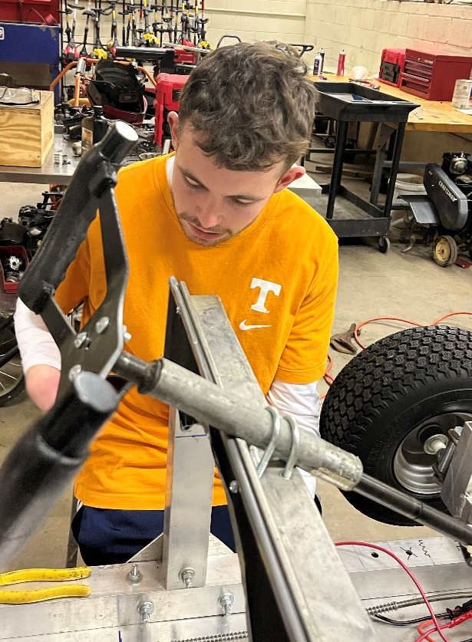
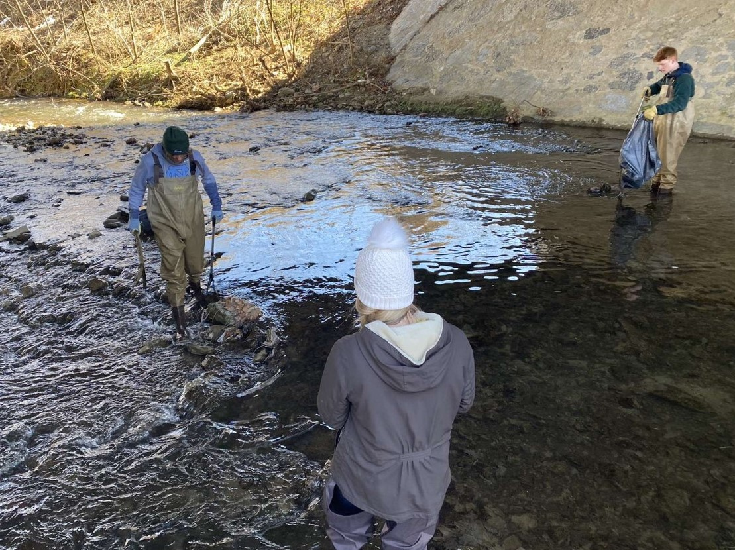
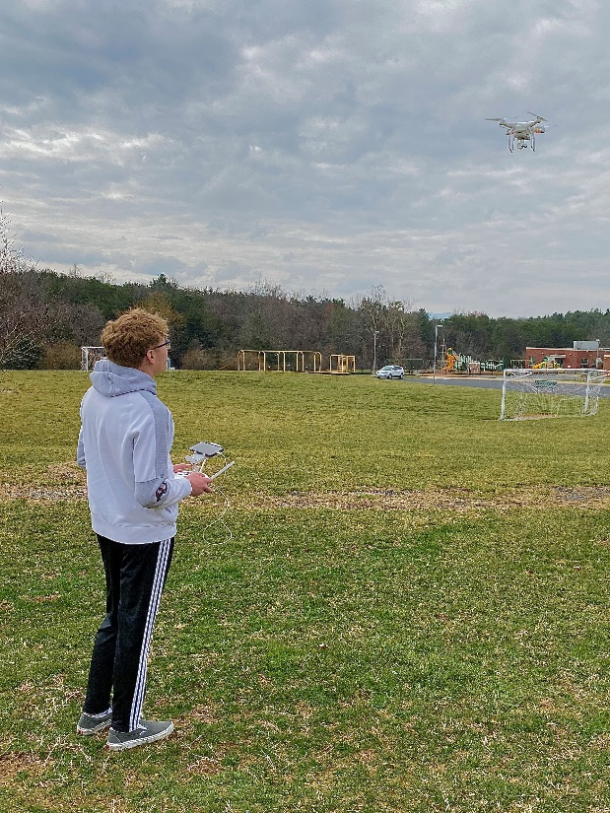
STEM
Notes:
SB

Slide 22
MATH & SCIENCE
If you will complete Algebra II by June 2022, select the following: Pre-Calculus | If you will complete Pre-Calculus by June 2022, select one of the following: Calculus (non-dual enrollment) DE Calculus - BRCC DE MTH 263 & 264 – 8 cr AP Calculus BC* * Strong standardized test scores and performance in Pre-Calculus needed
If you have NOT yet completed Physics, select one of the following: Physics AP Physics* * Strong standardized test scores and performance in Pre-Calculus needed. Calculus DE or AP Calculus is a co-requisite. * Students take two AP Exams - AP Physics C Mechanics Exam ($96) + AP Physics C Electricity and Magnetism Exam ($96) | If you have taken Physics AND have NOT completed Chemistry, select one of the following: Environmental Chemistry (non-dual enrollment) DE Environmental Chemistry
Notes:
SB
STEM student – welcome to take a photo of next two slides. Information is available on website registration.
Choose a Math course:
PreCalculus - If you will complete Algebra II by June 2022
Calculus strengthens skills learned in pre-calculus and advances to differential and integral calculus
Calculus Dual Enrollment – qualifying grades from Pre-Calculus required
AP Calculus is suitable for highly motivated and capable math students (Grade of A in Pre-Calculus highly recommended)
Choose one of the following Science Courses:
Physics is “usual” entry-level science class at SVGS
AP Physics is suitable for highly motivated and capable science students
Strong standardized test scores and performance in Pre-Calculus needed.
Calculus DE or AP Calculus is a co-requisite.
AP Physics C Mechanics Exam ($96) + AP Physics C Electricity and Magnetism Exam ($96)
If you have taken Physics AND have NOT completed Chemistry, select one of the following:
Environmental Chemistry (non-dual enrollment)
DE Environmental Chemistry

Slide 23
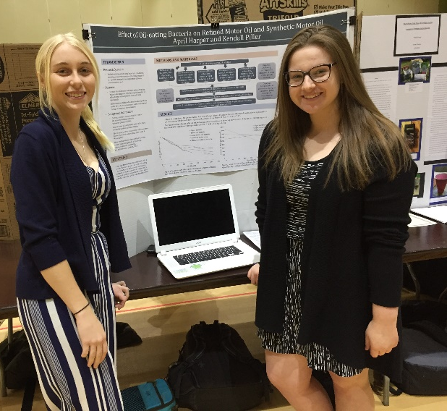
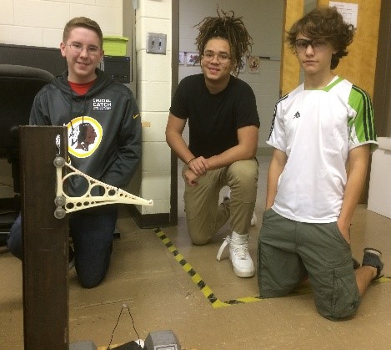
RESEARCH, TECHNOLOGY, & ENGINEERING
Select from one of the four courses shown below.
Scientific Research - Life Sciences | Scientific Research - Physical Sciences
Introduction to Engineering | Introduction to Computer Science
Notes:
SB
3rd Course is a Research, Technology and Engineering Course Elective:
Select from one of the four choices:
Scientific Research - Life Sciences
Scientific Research - Physical Sciences
Introduction to Engineering
Introduction to Computer Science

Slide 24

MANDATORY WORKSHOP - TECH, PHOTOS, & FORMS:
  July 26, July 28, August 2, OR August 4 -
  Sign up for a 1 hour session between 8 AM and 12 Noon from an upcoming link on our website (under admissions)
  MANDATORY ORIENTATION
  Monday, August 8 8:30 AM - 12 Noon
  FIRST DAY OF SCHOOL FOR ALL STUDENTS
  Tuesday, August 9 (all students) 7:40 AM – 10:52 AM
Notes:
BH
MANDATORY WORKSHOP - TECH, PHOTOS, & FORMS:
July 26, July 28, August 2, OR August 4 -
Sign up for a 1 hour session between 8 AM and 12 Noon from an upcoming link on our website (under admissions)
MANDATORY ORIENTATION
Monday, August 8 8:30 AM - 12 Noon
FIRST DAY OF SCHOOL FOR ALL STUDENTS
Tuesday, August 9 (all students) 7:40 AM – 10:55 AM

Slide 25

SVGS follows Augusta County Schools Academic Calendar
Daily - Homeroom called at 7:38 & begins at 7:40
Students are dismissed on a “rolling schedule” depending on home high school starting at 10:52 AM
Notes:
BH
SVGS follows Augusta County Schools Academic Calendar
Daily - Homeroom called at 7:38 & begins at 7:40
Students are dismissed on a “rolling schedule” depending on home high school starting at 10:52 AM

Slide 26
Monday, Tuesday, & Friday
Typical First-Year Student Lecture Schedule * Note: 3 SVGS Classes plus IWT
 | Fall | Spring
7:40 | SVGS – Block 1 | SVGS – Block 1
8:30 | SVGS – Block 2 | SVGS – Block 2
9:18 10:06 10:52 | SVGS – Block 3 SVGS – Block 4 Return to Home HS | SVGS – Block 3 SVGS – Block 4 Return to Home HS
11:15 - | Home HS 3rd Block/Lunch | Home HS 3rd Block/Lunch
3:15 | Home HS 4th Block | Home HS 4th Block
Notes:
BH
Lecture Schedule – All 4 blocks meet
* Note: 3 SVGS Classes plus IWT
For first year students that means 3 classes and IWT (Independent Work Time)
Monday, Tuesday, Friday

Slide 27
Wednesday & Thursday
Typical First-Year Student Lab Schedule Note: 3 SVGS Classes plus IWT
 | Wednesday | Thursday
7:40 | SVGS – Block 1 | SVGS – Block 3
9:18 10:52 | SVGS – Block 2 Return to Home HS | SVGS – Block 4 Return to Home HS
11:15 - | Home HS 3rd Block/Lunch | Home HS 3rd Block/Lunch
3:15 | Home HS 4th Block | Home HS 4th Block
Notes:
BH
Lab Days – Extended Blocks
Wednesday and Thursday
* Note: 3 SVGS Classes plus IWT

Slide 28
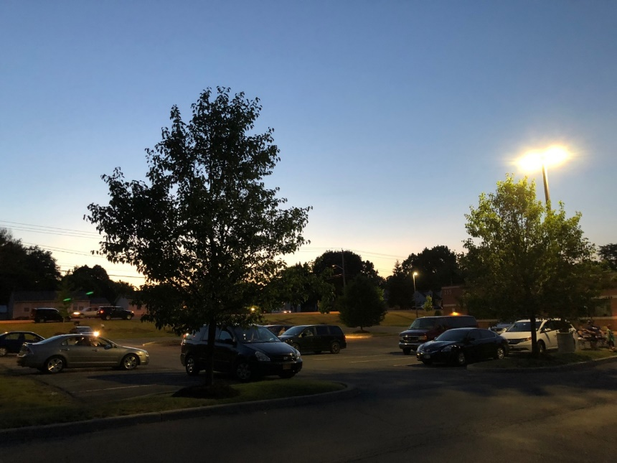
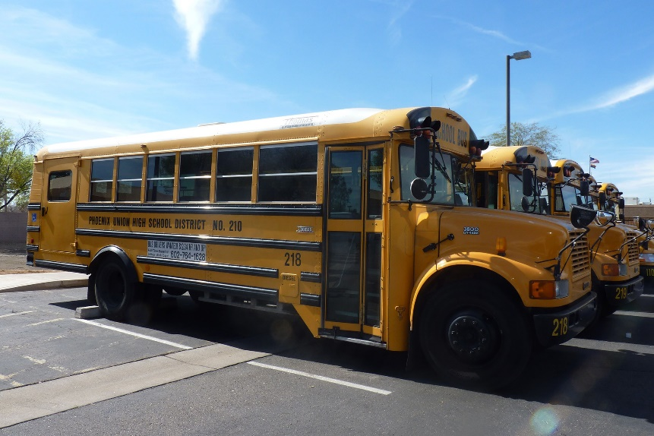
Transportation
DRIVING:
MUST have a signed permission form AND parking permit
RIDING:
Must have a signed permission form ride with another driver
DROP OFF:
Drop off in the morning
Ride VCTC bus back to home HS
VCTC buses leave at 11 AM to return to all high schools
Notes:
BH
Transportation
DRIVING:
MUST have a signed permission form AND parking permit
RIDING:
Must have a signed permission form ride with another driver
DROP OFF:
Drop off in the morning
Ride VCTC bus back to home HS
VCTC buses leave at 11 AM to return to all high schools

Slide 29
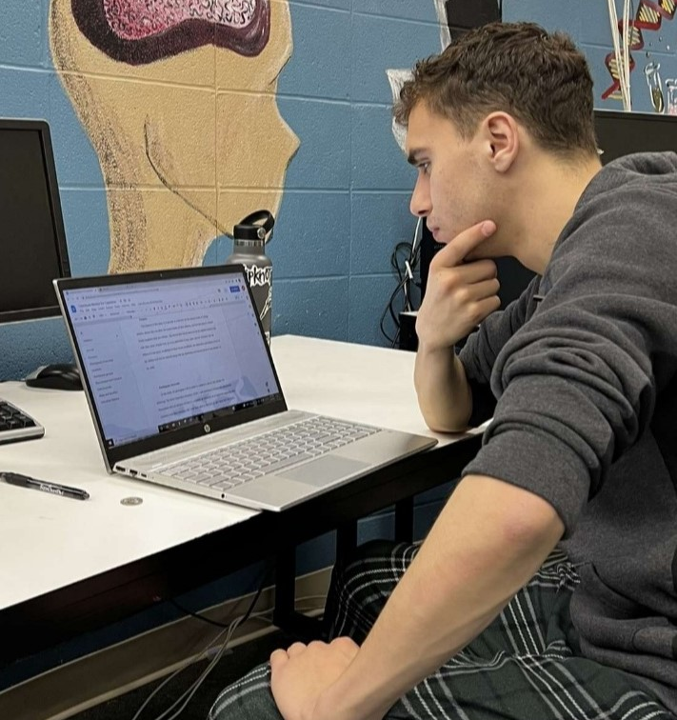
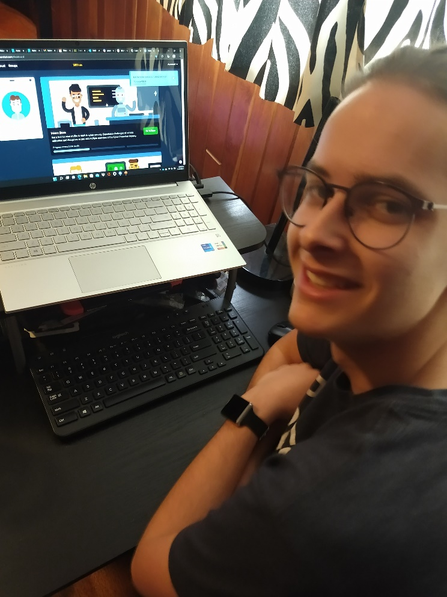
Technology
Must have home/evening access to the internet
SVGS open at 7 AM each school day with wireless access
School provided chromebooks work but do have some limitations
Access to Microsoft Office is preferable
Do not expect families to purchase a student computer
Notes:
BH
Technology:
Must have home/evening access to the internet
SVGS open at 7 AM each school day with wireless access
School provided chromebooks work but do have some limitations
Access to Microsoft Office is preferable
Do not expect families to purchase a student computer

Slide 30

Fees
Studio/Lab/Tech fees ($15)
AP classes
  $96 per exam invoiced in November
Dual Enrollment (DE) classes
  Tuition VARIES
  See course pre-registration form
  Fall tuition invoiced in August
  Spring tuition invoiced in January
Payment Plans available
Limited Financial aid available from PSAC based on need
Notes:
BH
Fees
Studio/Lab/Tech fees ($15)
AP classes
$96 per exam invoiced in November
Dual Enrollment (DE) classes
Tuition VARIES
See course pre-registration form
Fall tuition invoiced in August
Spring tuition invoiced in January
Payment Plans available
Limited Financial aid available from PSAC based on need

Slide 31
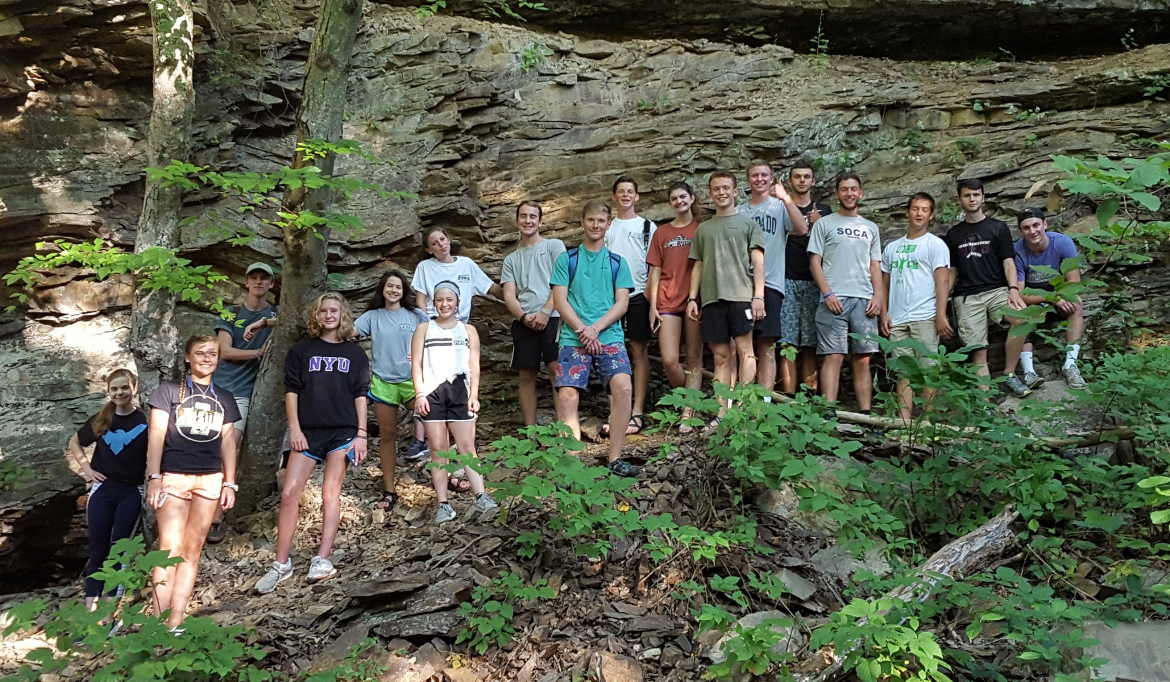
Questions
Notes:
Both

Slide 32

Summer Work for STEM Students
Notes:
Susan (Tues) or Bess (Thurs)

Slide 33

Two roads diverged in a wood, and I—
I took the one less traveled by,
And that has made all the difference.
Robert Frost
Welcome to this Journey!
Notes:
BH –
Robert Frost

