Slide 1

Welcome to SVGS!
New Student and Parent Meeting
Notes:
Congratulations!
Students - We are excited to welcome you to SVGS for 2023-24 school year.
Parents - Your student has worked hard for this opportunity and has been selected to become a valued part of a unique educational environment. This was an extremely competitive applicant pool with an acceptance rate of about 65%. Congratulations to you also! We recognize your impact and value your support.

Slide 2


SVGS “Legacy”
As an SVGS student, you will benefit because of the dedication, commitment, and service of those before you.
It is your responsibility to continue that legacy.

Slide 3
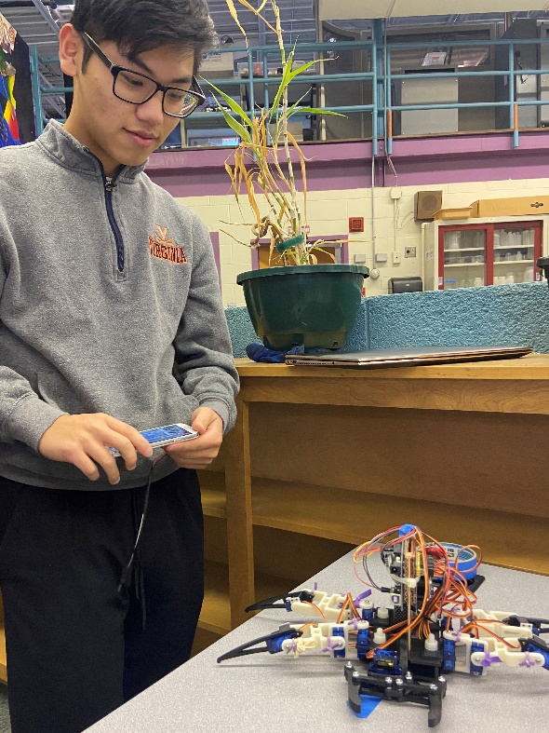
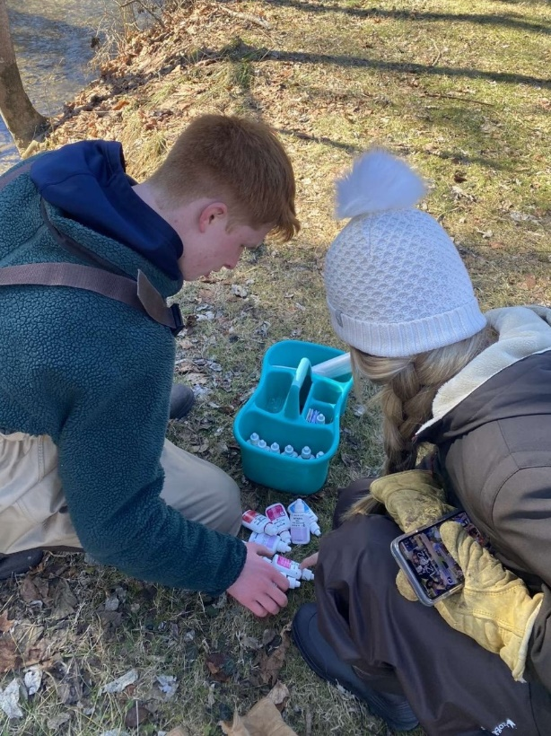
Expectations of Students
Value Opportunities
Respect
  Accomplishments
  Talents
  Differences
Contribute
  Learning environment
  Group & individual work
Show Responsibility
    Attendance
    Promptness
    Communication
    Participation
Notes:
As students, you have expectations as valued members of this school: This includes your responsibilities to Governors School, to your fellow students and most importantly yourself.
Value
the opportunities and resources you have here to learn and grow
Respect
The accomplishments, talents, and differences of those around you – both students and staff
Being different is interesting – there is nothing inferior or superior about it.
None of you are normal –Everyone has his or her quirks , you will get on each others nerves at times.
Contribute
The learning environment
The classroom experience
Group and individual work –
Some of you like to work by yourself, some like to work together. You will do both.
When you work as a group, expect to pull your weight.
Show Responsibility
Attend
Be Prompt
Communicate
Ask for help when needed
Talk with teachers about absences/conflicts
Participate
Take responsibility for your own learning.
You have the power and talent to contribute to discussions and that is what we expect.
Be responsible to yourself by respecting and trusting your abilities. You would not be here if we didn’t see that in you.

Slide 4
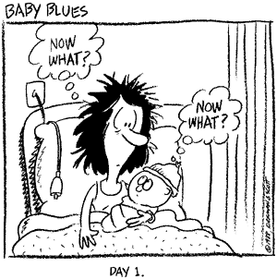
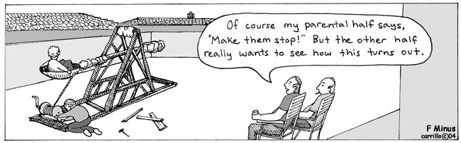
Expectations of Parents
Support Development
  Intellectual
  Emotional
Guide Time Management
Ask Questions
Get Involved
Notes:
From Day 1 – we may have wished to have an instruction manual that will guide us in raising our children
Support your child’s development
intellectual
emotional
Ask your child questions
Guide/Support time management
Get involved in their learning and in our programs (PSAC)
- as you have throughout their education
- may/will take more during this experience – they will be challenged in new ways
- recognize their positive efforts that have gotten students to this place – continue to honor their achievements!

Slide 5

Depth and Quality of Work
  Time and Preparation vs. Talent and Ability
  Complex Material
  Compact Time Frame
  Faster Pace
  Outside of Previous Comfort Zone
  Unable to Coast
Notes:
Simply completing an assignment doesn’t guarantee a good grade. It is the depth and quality of work that counts.
At SVGS, this requires more time and preparation. Simply being talented in one area or medium isn’t enough because you will be expected to try new things.
Students will be asked to learn complex material
Material is dense – compacted time frame for advanced learning
Work at a different pace, in different ways through different activities.
Some student will be out of their previous comfort zone.
Some are used to coasting – listening quietly in class, competing what was asked, glancing at the textbook while texting with friends, completing HW during the 90 minute block or in the morning between the shower and the door.
In the past that might have been enough.
That does not work at SVGS.

Slide 6

Our “Equation for Success”
  Level of Challenge > Current Skill = Learning
Notes:
Equation for Success:
A Level of Challenge greater than a Student’s Current Skills equals LEARNING.
You are not learning anything, if you can do it already.
Struggle is a critical part of learning; it is not failure.
So – let’s talk more about that struggle…

Slide 7

Students may face some
unexpected pitfalls!
Notes:
Again - Here are some specific challenges:
Higher Rigor
Challenging material
New approach to learning
This joke’s kind of “cheesey” – But be prepared for a “grater workload”

Slide 8

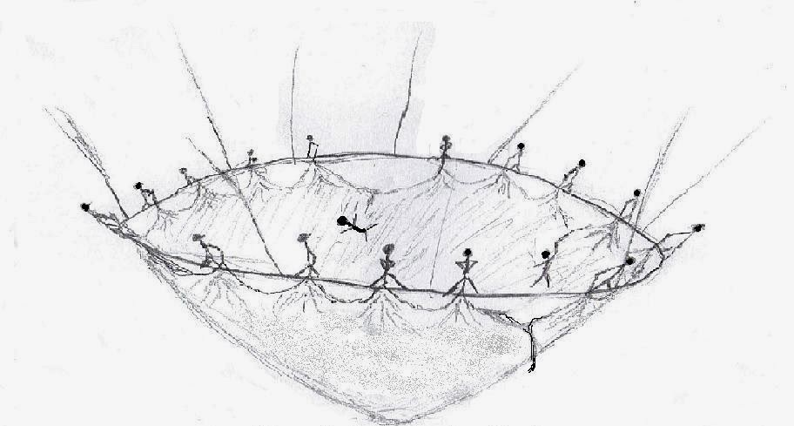
College
with a “Safety Net”
Notes:
When things get tough – how do we cope? How do we not just survive - but thrive?
At Governor’s School, we are a community of learners. Students, teachers, and staff are actively learning together. Connected. Cooperative. Supportive.
Despite this support, students will experience times that are uncomfortable or stressful. This is part of transition. This is part of growth. Growth both Academically and Emotionally requires the learning of life skills.
As said previously - To learn, challenge must exceed skill. You cannot learn anything if you can do it already. Struggle is a critical part of learning; it is not failure.
During our high school visits this past year – a current student used a phrase that has stayed with me –
“Gov School is like college, with a safety net.”

Slide 9
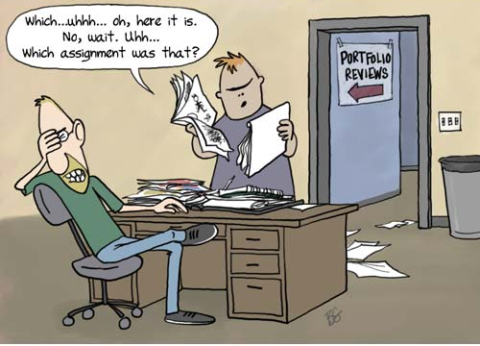
Organization
Notes:
Organization
Students have many projects and many activities going at once.
Keeping up with what it due when is a challenge.
Teachers have course materials on CANVAS and have assignments posted there.
Many STEM teachers use a program called Web Aassign.
Students will get accustomed to looking at CANVAS and Web Assign for resources.
Assignments will be given – give a due date – give time – student responsibility to stay on top of those deadlines – this will feel like a contrast to HS
CALENDAR – Parents – help your students create a system of keeping track before they get in over their head.
SVGS Email – Must Check
SVGS Infinite Campus Student Portal and Parent Portal – Separate from ACS, SHS (Power School), WHS

Slide 10
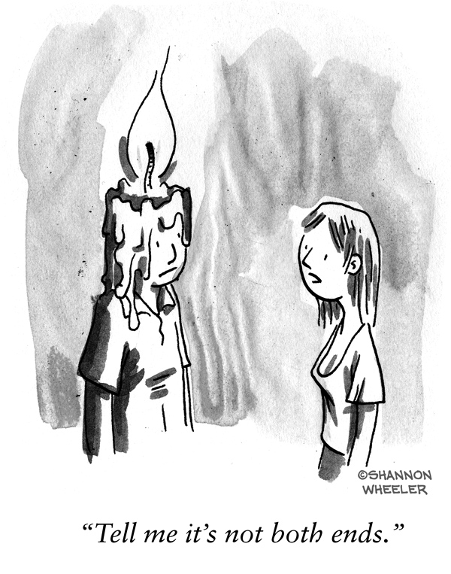
Time Management
Notes:
Time Management
Our students are busy, active and social young adults. Most are involved in many extra-curricular activities, have outside work, and family responsibilities.
In a typical college schedule, students might have a class a 10 then another at 1. Not enough time to go back to their room but time to be productive.
Here their classes will be back to back. Learning to effectively manage time and prioritize tasks are essential skills. Students currently have different skills in their ability to apply that in SVGS classes. Students will learn to make productive use of their “down time” or independent work block (IWT). But parents can support that process.

Slide 11
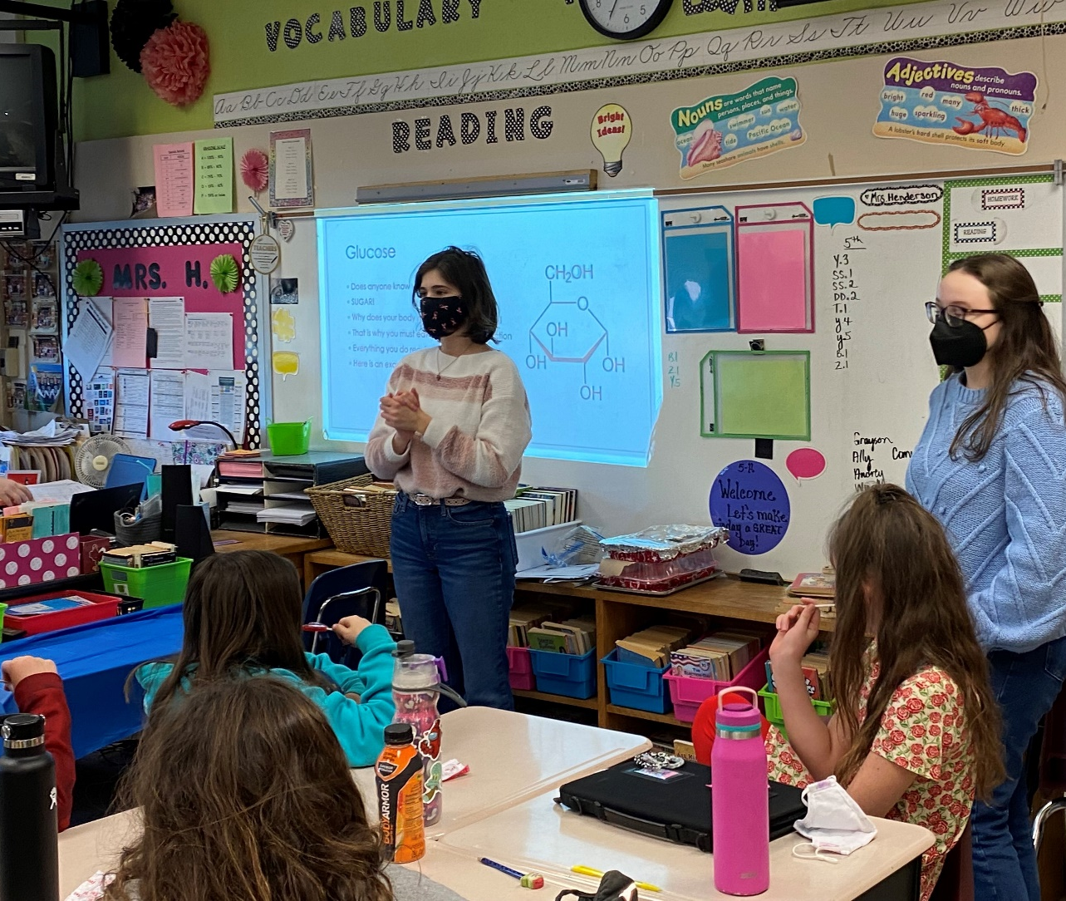
Tuesday, April 25 | “Memo of Understanding” Due
Tuesday, May 2 | Course Requests Due
  Find Forms on SVGS Website
SVGS.k12.va.us

Slide 12
Advanced Placement (AP)
Dual Enrollment (DE)
Students take a national exam at end of course – early May
Performance on exam determines whether credit is earned
Score range is 1-5: occasionally a 3 will earn credit but more usually require a 4 or 5
Score is a result of mastery of content, standardized test-taking skills, AND health/attitude on day of exam
Accepted nation-wide at most highly selective universities
$100 per AP Exam
Taught at SVGS by SVGS teachers
Credit from area college is earned through successful completion of class (grade of B or better) rather than one-time test
Credit is accepted to all public universities in Virginia
*Note – see next slide
DE Credits are less expensive than on-campus tuition
4 credit class – JMU DE = $400
4 credit class – BRCC DE = $125
  (Prices are approximate)

Slide 13

    Review the “transfer guide” found on your specific college of interest’s website
    ALWAYS verify with colleges AND discuss with a college admissions counselor.
    Ask not just “Will they take the credit?” but “How will they take the credit?”
    May NOT transfer as required courses for general education or within major – may be elective credit

Slide 14
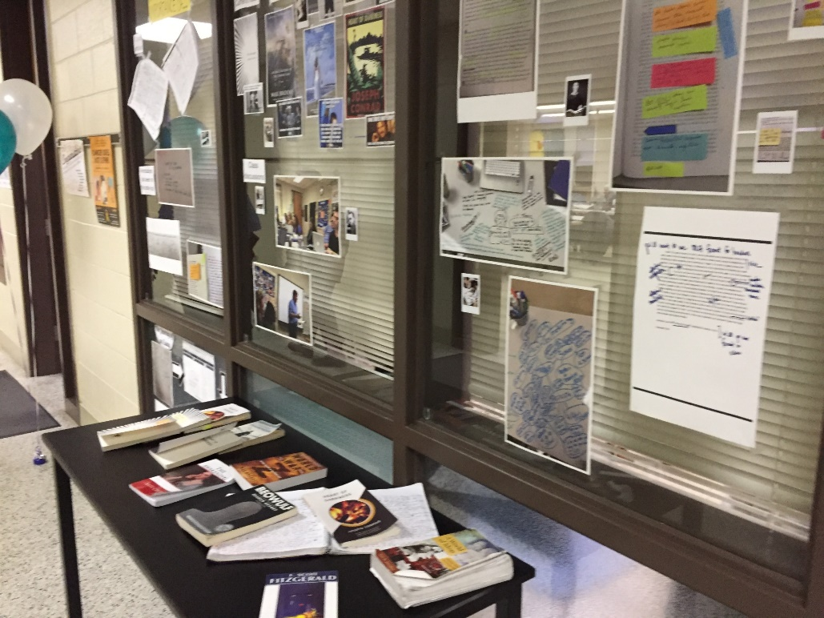
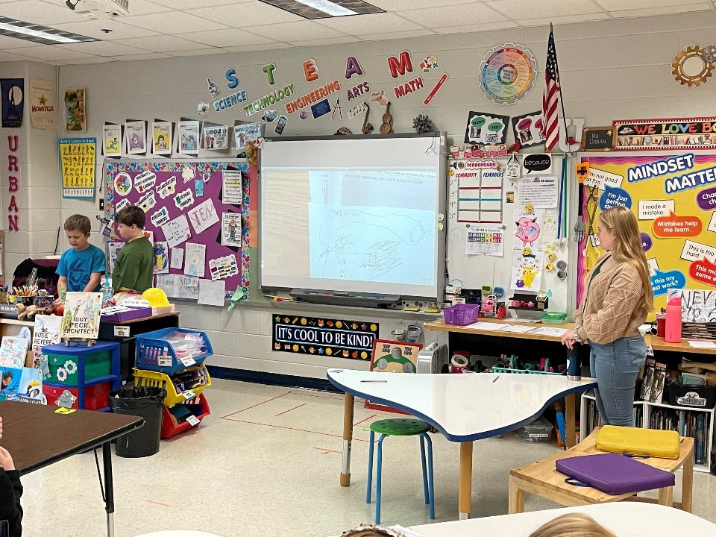

ARTS & HUMANITIES

Slide 15
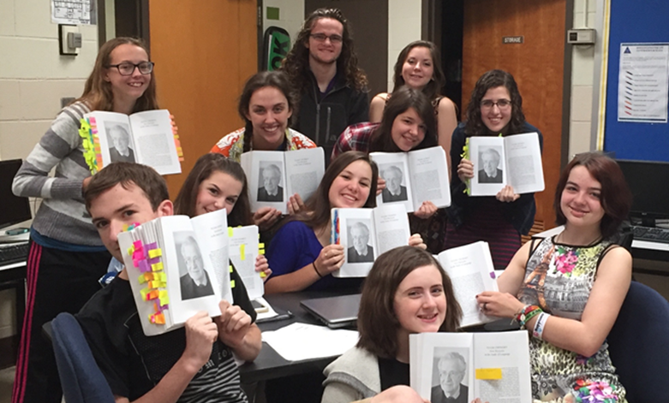
ARTS & HUMANITIES
Select three of the courses shown below.
 | Junior Year | Senior Year
Fulfills English Requirement | * Literature, Comp, and Ideas I (DE) (Required for all AH Juniors) | * Literature, Comp, and Ideas II (DE) (Recommended, but not Required)
Humanities & Appreciation | * Humanities in Western Culture (DE) * Art History (DE) * Intro to Theatre (DE) | * Communications (DE) * Art History (DE) * Intro to Theatre (DE)
Socio-Cultural and Skills | * Psychology (AP) * Developmental Psychology (DE) * Acting I * Film I * Teachers for Tomorrow I (DE) | * Psychology (AP) * Developmental Psychology (DE) * Sociology of the Family (DE) * Sociology of Mass Media (DE) * Acting II * Film I or II * Teachers for Tomorrow I or II (DE)

Slide 16
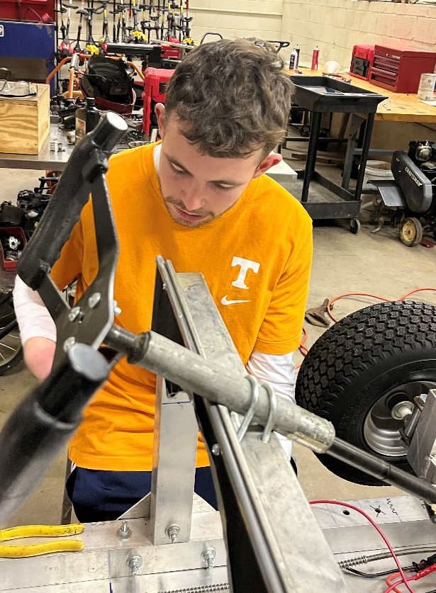
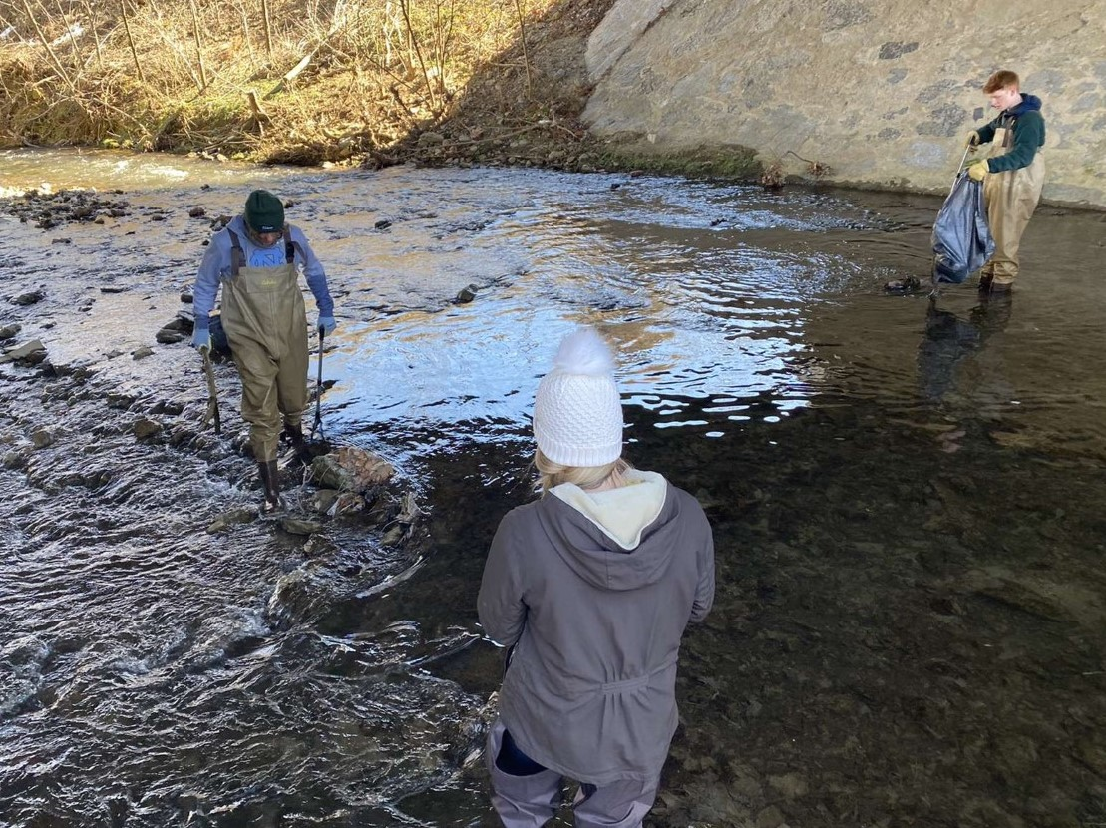
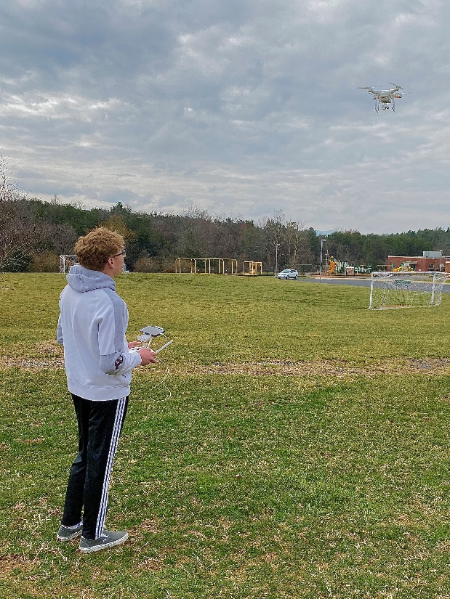
STEM

Slide 17
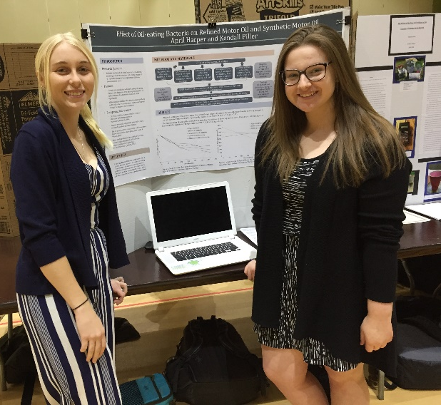
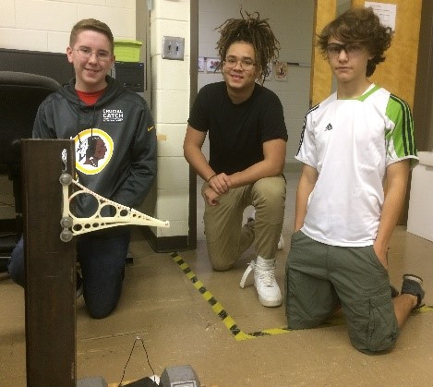
RESEARCH, TECHNOLOGY, & ENGINEERING
Select one class from the four courses shown below.
Scientific Research - Life Sciences | Scientific Research - Physical Sciences
Introduction to Engineering | AP Computer Science

Slide 18
MATH
If you will complete Algebra 2 by June 2023, select the following: | If you will complete Pre-Calculus by June 2023, select one of the following:
Pre-Calculus | Calculus (non-DE) OR DE Calculus OR AP Calculus BC * See Comparison Chart between DE Calculus and AP Calculus BC

Slide 19
SCIENCE
If you have NOT completed Physics, select one of the following: | If you HAVE taken Physics AND HAVE NOT completed Chemistry, select one of the following:
Physics OR AP Physics* * See Comparison Chart between Physics and AP Physics * DE Calculus or AP Calculus is a co-requisite for AP Physics. | Environmental Chemistry (non-DE) OR DE Environmental Chemistry

Slide 20
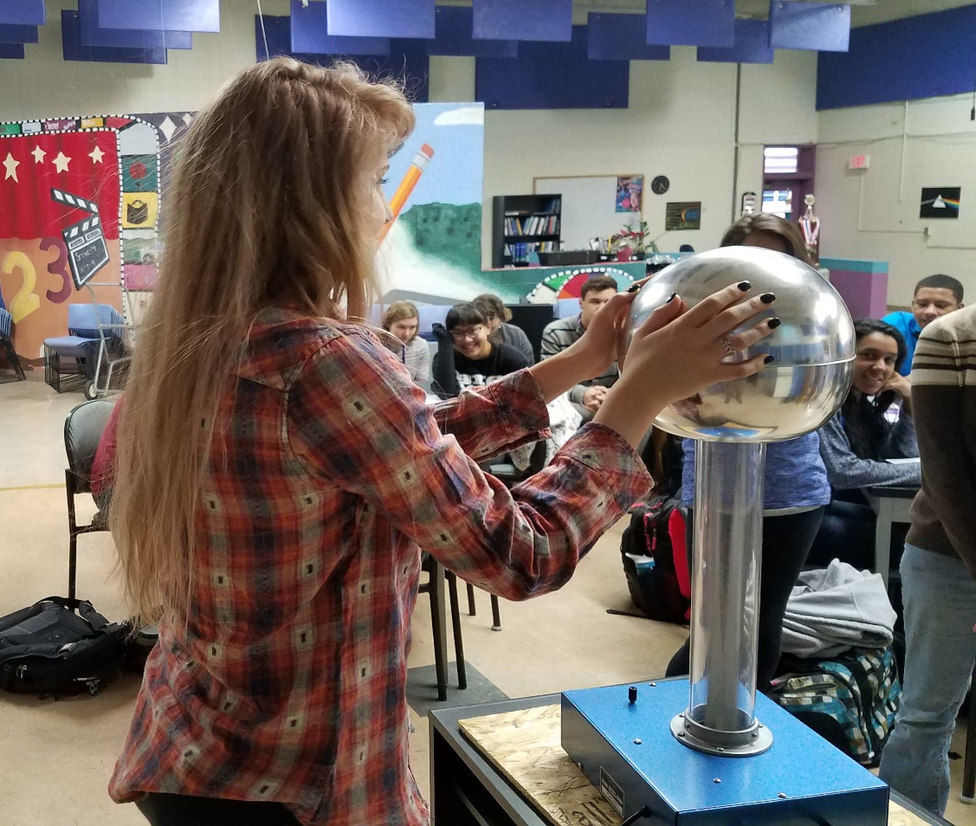
A Note about CHEMISTRY
Most STEM First- Year Students take Physics at SVGS.
If you haven’t had Chemistry – might want to consider for Junior year at home high school
Chem is Pre-req for many SVGS senior science courses.

Slide 21


Summer Work for STEM Students
There will be Math/Physics Enrichment
Aleks and Kahn Academy
Students will receive information from their Math teacher in late May/early June

Slide 22

MANDATORY WORKSHOP - TECH, PHOTOS, & FORMS:
  July 28, July 31, August 2, OR August 3 -
  Sign up for a 1 hour session between 8 AM and 12 Noon from an upcoming link on our website (under admissions)
  MANDATORY ORIENTATION
  Tuesday, August 8th - 8:30 AM - 12 Noon
  FIRST DAY OF SCHOOL FOR ALL STUDENTS
  Wednesday, August 9th (all students) - 7:40 AM – 10:52 AM

Slide 23

SVGS follows Augusta County Schools Academic Calendar
Daily - Homeroom called at 7:38 & begins at 7:40
Students are dismissed on a “rolling schedule” depending on home high school starting at 10:52 AM

Slide 24
Monday, Tuesday, & Friday
Typical First-Year Student Lecture Schedule 3 Classes plus IWT
 | Fall | Spring
7:40 | SVGS – Block 1 | SVGS – Block 1
8:30 | SVGS – Block 2 | SVGS – Block 2
9:18 10:06 10:52 | SVGS – Block 3 SVGS – Block 4 Return to Home HS | SVGS – Block 3 SVGS – Block 4 Return to Home HS
11:15 - | Home HS 3rd Block/Lunch | Home HS 3rd Block/Lunch
3:15 | Home HS 4th Block | Home HS 4th Block

Slide 25
Wednesday & Thursday
Typical First-Year Student Lab Schedule 3 Classes plus IWT
 | Wednesday | Thursday
7:40 | SVGS – Block 1 | SVGS – Block 3
9:18 10:52 | SVGS – Block 2 Return to Home HS | SVGS – Block 4 Return to Home HS
11:15 - | Home HS 3rd Block/Lunch | Home HS 3rd Block/Lunch
3:15 | Home HS 4th Block | Home HS 4th Block

Slide 26
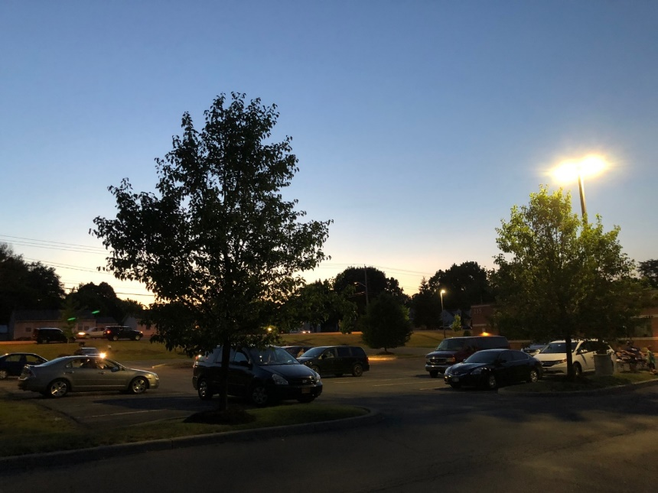
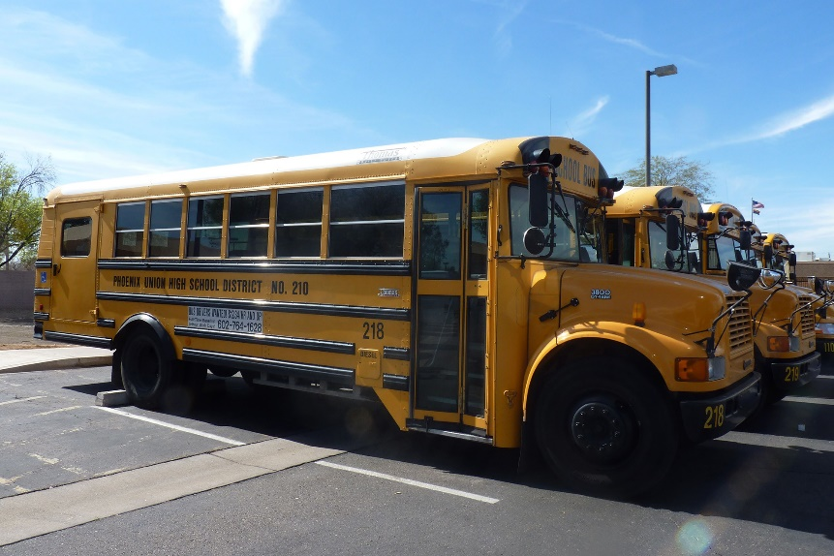
Transportation
DRIVING:
MUST have a signed permission form AND parking permit. Payment is dependent upon division.
RIDING:
Must have a signed permission form to ride with another driver
DROP OFF:
Drop off in the morning
Ride VCTC bus back to home HS
VCTC buses leave at 11 AM to return to all high schools

Slide 27
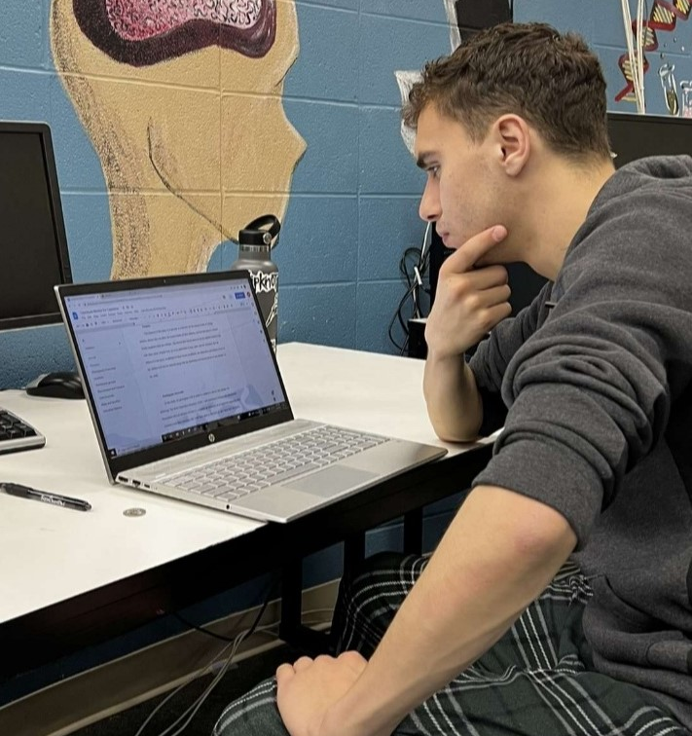
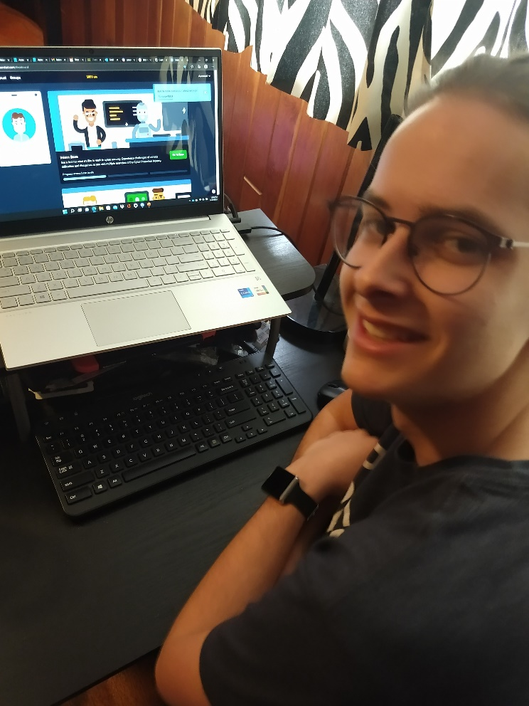
Technology
Must have home/evening access to the internet
SVGS open at 7 AM each school day with wireless access
School provided chromebooks work, but do have some limitations
Access to Microsoft Office is preferable
We do not expect families to purchase a student computer

Slide 28

Fees
Studio/Lab/Tech fees ($15)
AP classes
  $100 per exam invoiced in November
Dual Enrollment (DE) classes
  Tuition VARIES
  See course pre-registration form
  Fall tuition invoiced in August
  Spring tuition invoiced in January
Payment Plans available
Limited Financial aid available from PSAC based on need

Slide 29
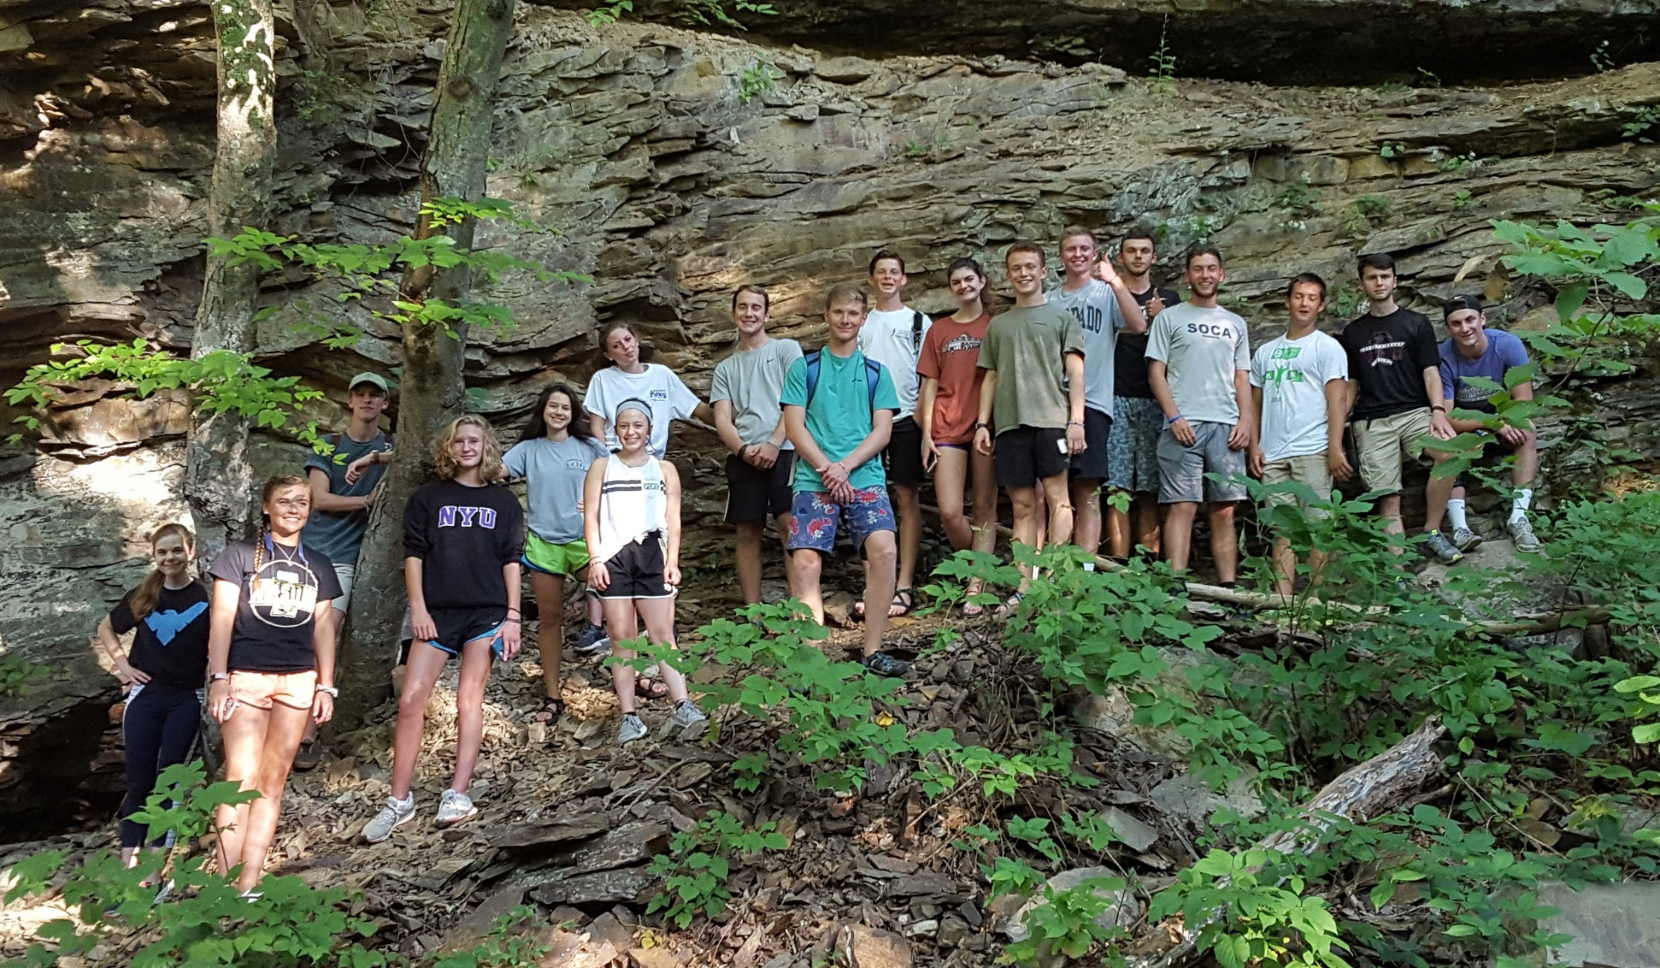
Questions

