Slide 1

Welcome to SVGS!

Slide 2


SVGS “Legacy”
As an SVGS student, you will benefit because of the dedication, commitment, and service of those before you.
It is your responsibility to continue that legacy.
Notes:
You benefit from being recognized in the community and with colleges as being a governors school student only because of the dedication, commitment, and service of those students before you.
It is your responsibility to continue that legacy!

Slide 3
SVGS Question and Answer Session

Slide 4
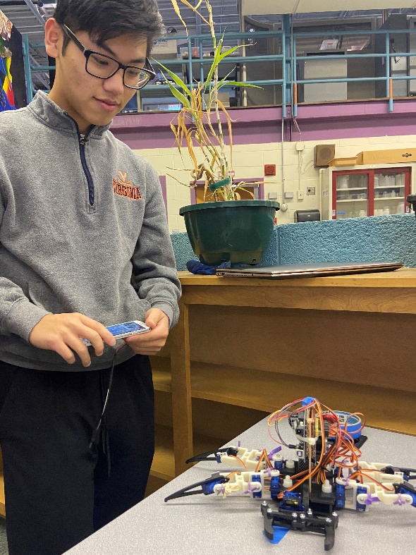
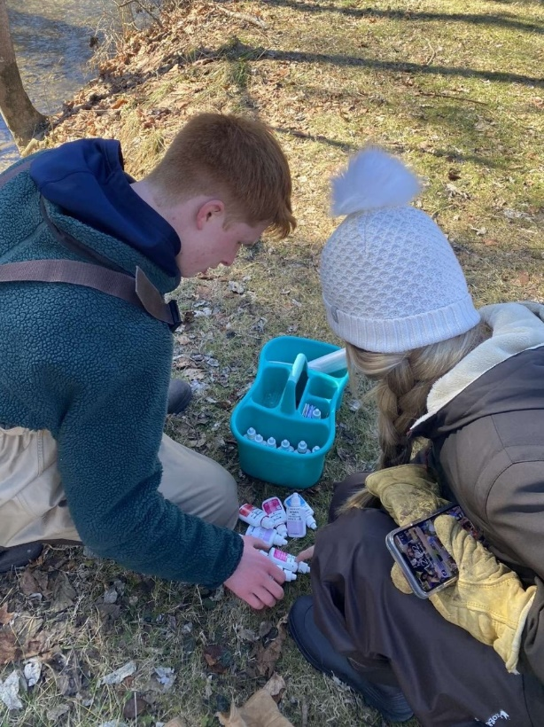
Expectations of Students
Value Opportunities
Respect
  Accomplishments
  Talents
  Differences
Contribute
  Learning environment
  Group & individual work
Show Responsibility
    Attendance
    Promptness
    Communication
    Participation
Notes:
As students, you have expectations as valued members of this school. This includes your responsibilities to Governors School, to your fellow students and most importantly yourself.
Value
the opportunities and resources you have here to learn and grow
Respect
The accomplishments, talents, and differences of those around you – both students and staff
Being different is interesting – there is nothing inferior or superior about it.
None of you are normal –Everyone has his or her quirks , you will get on each others nerves at times.
Contribute
The learning environment
The classroom experience
Group and individual work –
Some of you like to work by yourself, some like to work together. You will do both.
When you work as a group, expect to pull your weight.
Show Responsibility
Attend
Be Prompt
Communicate
Ask for help when needed
Talk with teachers about absences/conflicts
Participate
Take responsibility for your own learning.
You have the power and talent to contribute to discussions and that is what we expect.
Be responsible to yourself by respecting and trusting your abilities. You would not be here if we didn’t see that in you.

Slide 5

SVGS follows Augusta County Schools Academic Calendar
  No School Days
  Weather Cancellations and Delays – posted on SVGS website ASAP
  2 Hour Delay is 1 hour 50 minutes at SVGS
Daily - Homeroom called at 7:38 & begins at 7:40
Students dismissed on a “rolling schedule” based on home high school starting at 10:52 AM
  Benefits all students’ safety
  Only leave after dismissed
  Avoid courtyard unless waiting on a bus
Notes:
SVGS follows Augusta County Schools Academic Calendar
No School Days
Weather Cancellations and Delays – posted on website ASAP
Daily - Homeroom called at 7:38 & begins at 7:40
Students are dismissed on a “rolling schedule” depending on home high school starting at 10:52 AM

Slide 6
Monday, Tuesday, & Friday
Typical First-Year Student Lecture Schedule 3 Classes plus IWT
7:40 | SVGS – Block 1 | Yearlong Classes
8:30 | SVGS – Block 2 | At SVGS
9:18 10:06 10:52 | SVGS – Block 3 SVGS – Block 4 Return to Home HS
11:15- | Home HS 3rd Block/Lunch
3:15 | Home HS 4th Block
Notes:
Lecture Schedule – All 4 blocks meet
For first year students that means 3 classes and IWT (Independent Work Time)
Monday, Tuesday, Friday

Slide 7
Wednesday & Thursday
Typical First-Year Student Lab Schedule 3 Classes plus IWT
 | Wednesday | Thursday
7:40 | SVGS – Block 1 | SVGS – Block 3
9:18 10:52 | SVGS – Block 2 Return to Home HS | SVGS – Block 4 Return to Home HS
11:15 - | Home HS 3rd Block/Lunch | Home HS 3rd Block/Lunch
3:15 | Home HS 4th Block | Home HS 4th Block
Notes:
Lab Days – Extended Blocks
Wednesday and Thursday

Slide 8
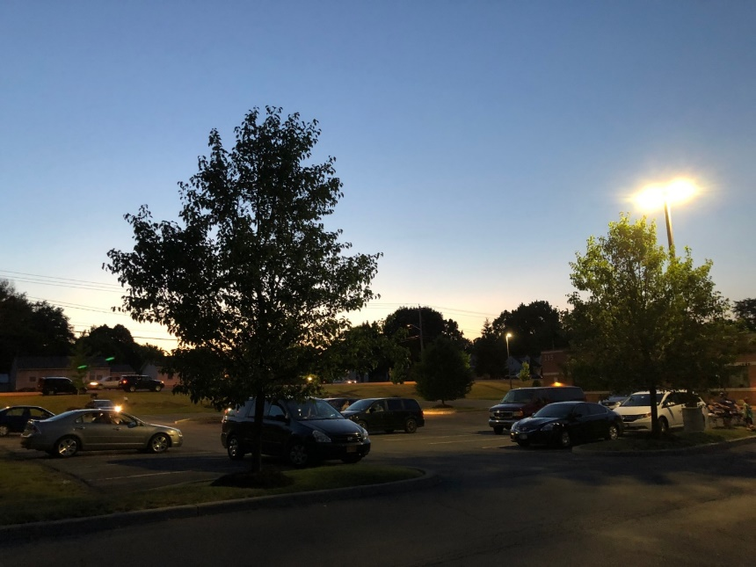
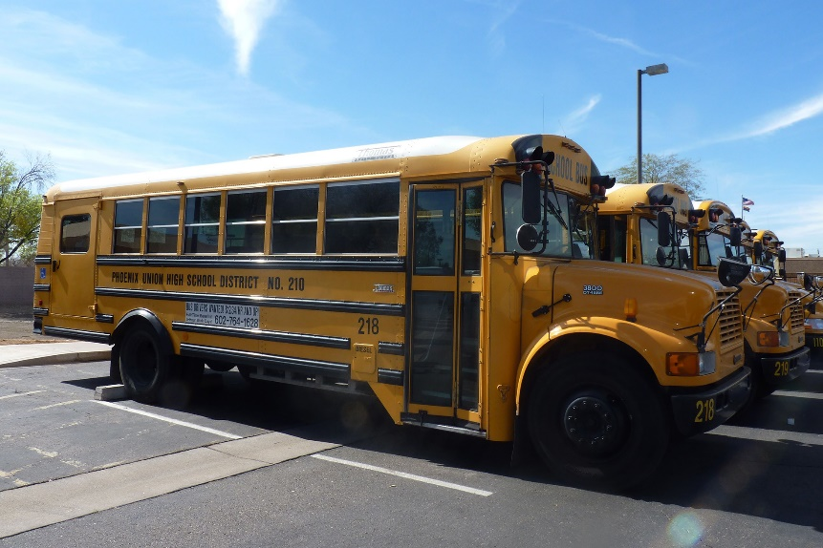
Transportation
DRIVING:
MUST have signed permission form and parking pass
RIDING:
Must have a signed permission form to ride with another student driver
DROP OFF:
Drop off in the morning
Ride VCTC bus back to home HS
VCTC buses leave at 11 AM to return to all high schools
Notes:
Transportation
DRIVING:
MUST have a signed permission form AND parking permit
RIDING:
Must have a signed permission form ride with another driver
DROP OFF:
Drop off in the morning
Ride VCTC bus back to home HS
VCTC buses leave at 11 AM to return to all high schools

Slide 9


Parking
HEAVEN:
Lot closest to SVGS classrooms – nearest to Wilson Elementary
Fills early
Full row next to building sidewalk reserved for staff and SVGS guests – not students
EGYPT:
Lot on far side of the building
Full row next to building sidewalk reserved for staff and SVGS guests – not students
Notes:
Parking

Slide 10
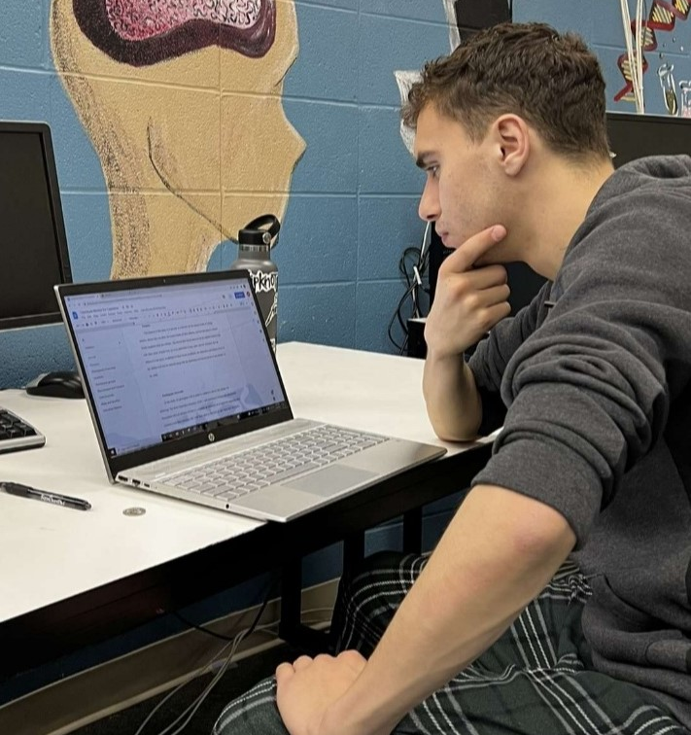
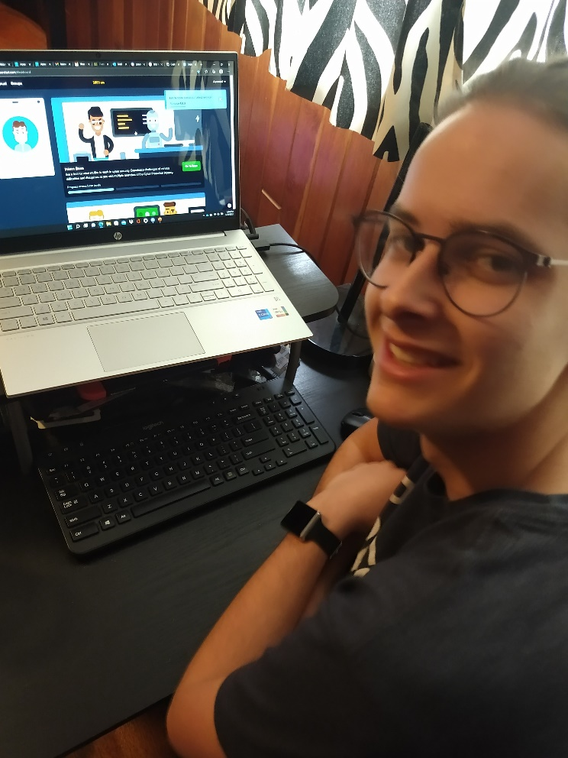
Technology
Must have home/evening access to the internet
SVGS open at 7 AM each school day with wireless access
School provided chromebooks work but do have some limitations
Access to Microsoft Office is preferable
Do not expect families to purchase a student computer
Notes:
Technology:
Must have home/evening access to the internet
SVGS open at 7 AM each school day with wireless access
School provided chromebooks work but do have some limitations
Access to Microsoft Office is preferable
Do not expect families to purchase a student computer

Slide 11
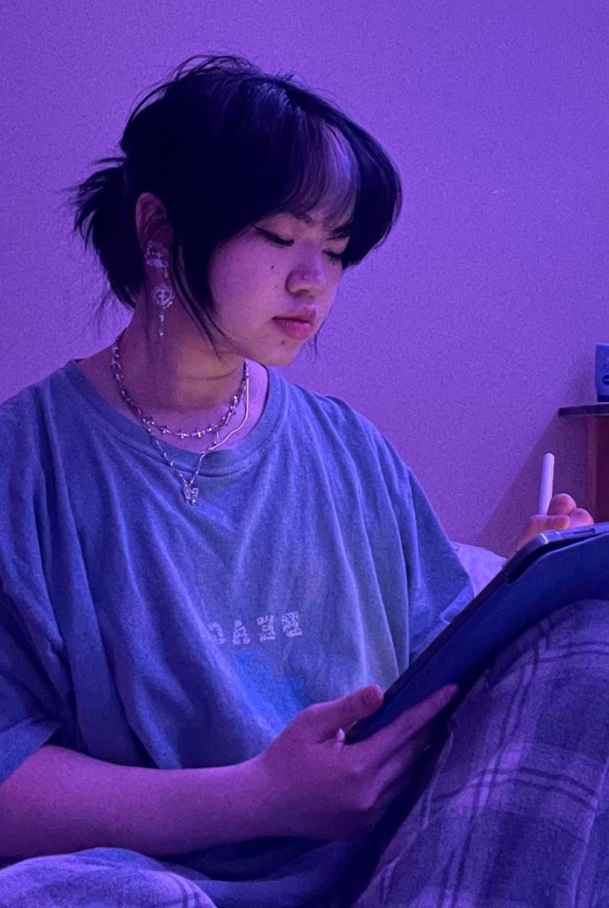
Fees
AP Exam Fees and DE Credit Tuition
Invoices were sent home.
Make payments in the SVGS office
Payment Plans available
Limited Financial aid available from PSAC based on need
Schedules are complete – no schedule changes
Notes:
Fees
AP classes
$100 per exam invoiced in November
Dual Enrollment (DE) classes
Tuition Varies based on number of credits
Payment Plans available
Limited Financial aid available from PSAC based on need

Slide 12
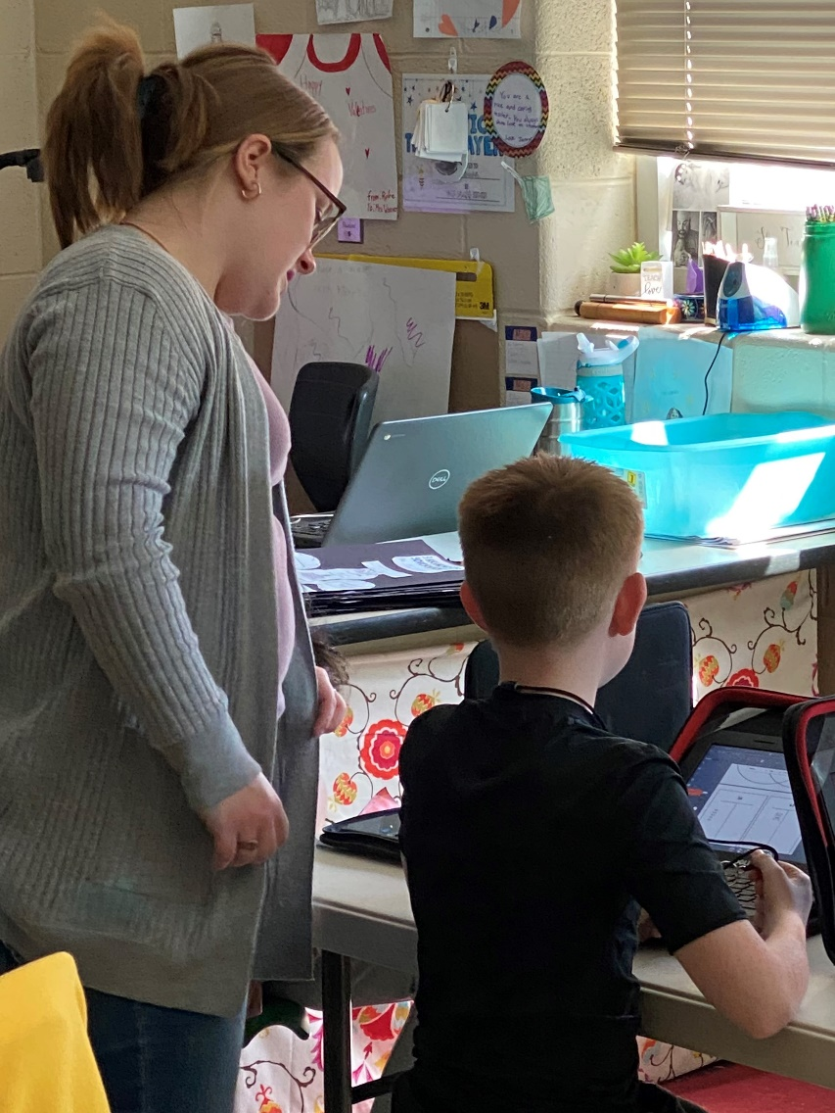
Back to School Night
Thursday, August 8th
6:30 – 8PM
Family Welcome!

Slide 13
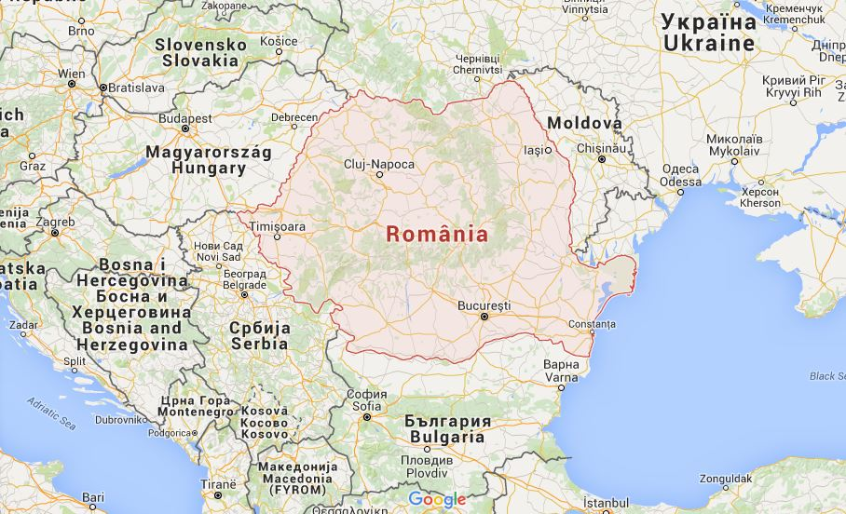
Romanian Exchange Experience
Interested Students talk to Ms. Nelson

Slide 14


